Slide 1



Analysis of Housing Price Data
Exploring Factors Influencing House Prices
Foday Deen-Swarray
11/16/2024

Slide 2

Introduction
Objective: To investigate the factors that influence housing prices.
Statistical Question: What factors that affect the selling price of houses?

Slide 3
Key Variables
Price
Area
Number of Bedrooms
Number of Bathrooms
Location

Slide 4
Exploratory Data Analysis
Mean: STD DEV:
Price - 4.767 Price - 1.8704
Area - 5.150 Area - 2.1701
Bedrooms - 2.965 Bedrooms - 7.3806
Bathrooms - 1.286 Bathrooms - 5.0247
Mode:
Price - 350000
Area - 6000
Bedrooms - 3.0
Bathrooms - 1.0

Slide 5
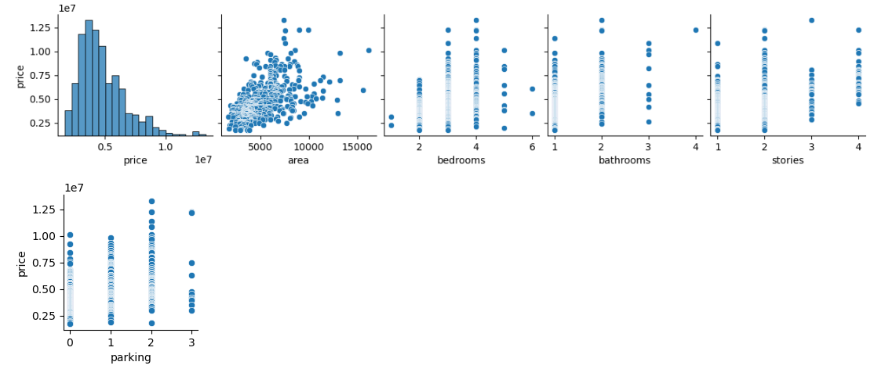
Visualization

Slide 6
Strong Influencers:
Area positively correlates with price
Number of bedrooms significantly affects pricing
Location is crucial in determining market value

Slide 7
What Was Missed:
Some of the key things that was missing was interactional effects between variables
Seasonal trends in housing prices
Potential Additional Variables:
Property age
Lot size
Neighborhood crime rates

Slide 8
Challenges Faced
Data Cleaning: Confusion in identifying outliers.
Visualization: Difficulty in visualizing complex relationships.
Understanding: Gained insights into EDA complexities and analytical depth.

Slide 9
Conclusion
Summary of Insights: Key factors influencing housing prices identified.
Future Recommendations: include more variables and interactions in analysis
Reassess assumptions about relationships between variables.

Slide 10
Thank you
Questions

